Slide 1



UNH SEDS
CEPS Engineering Organization
High Power Rocketry
University of New Hampshire
Students for the Exploration and Development of Space

Slide 2

Recruitment Program – Monday’s at 8:00 pm in Kings S172
Information Night
Tonight!
Meet The Team
Who is UNH SEDS? Who are you?
Rocket Building Techniques Workshop
How do you build a rocket from scratch? Make sure it works on the pad? We got you.
Team Selection/Mentor Pairing
Let’s get you up to speed on the projects that interest you… and get a friend!
Week 1
9/11
Week 2
9/16
Week 3
9/23
Week 4
9/30
University of New Hampshire
Students for the Exploration and Development of Space
Notes:
EE major too

Slide 3

Week 3
9/23
Will also be scheduling private chats with Charlie
Goals?
Aspirations?
Advice?
Get to know each other
Rocket Building Techniques Workshop
How do you build a rocket from scratch? Make sure it works on the pad? We got you.
University of New Hampshire
Students for the Exploration and Development of Space
Notes:
EE major too

Slide 4

Week 4
9/30
Will also do a full-session on introducing you to team software, integrating you to the team and engineering meeting times
Team Selection/Mentor Pairing
Let’s get you up to speed on the projects that interest you… and get a friend!
University of New Hampshire
Students for the Exploration and Development of Space
Notes:
EE major too

Slide 5
https://forms.gle/aNSMZnuTi85CHRen6
University of New Hampshire
Students for the Exploration and Development of Space
Notes:
EE major too

Slide 6
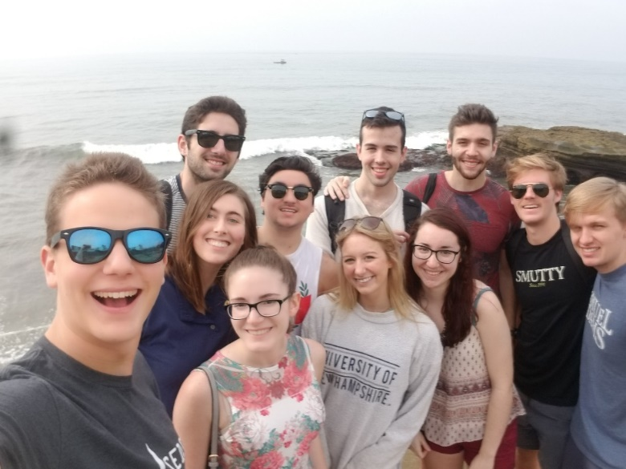
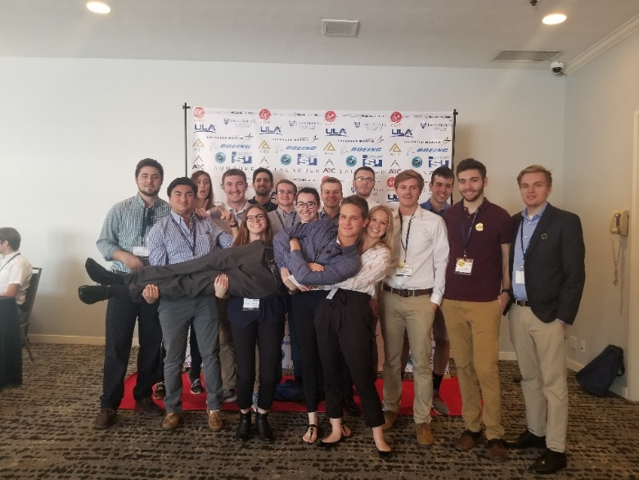
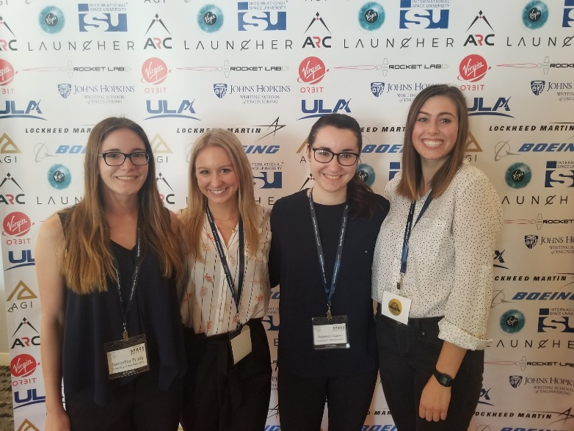
SpaceVision
SEDS USA hosts a national conference every year called ‘SpaceVision’ where many of the various SEDS chapters congregate to network and listen to speakers. This year, it will be on November 2019 in Arizona State University. We brought 16 of our members to take part in the 2018 SpaceVision located in San Diego California.
University of New Hampshire
Students for the Exploration and Development of Space
Notes:
EE major too

Slide 7
SpaceVision
Need expressed interest or For-Sure attendance by end of next week from current members and potential recruits
Will need to finalize confirmed headcount by Oct 4th latest!
Will probably be 400 dollars?
University of New Hampshire
Students for the Exploration and Development of Space
Notes:
EE major too

